Slide 1
Chapter 2:Bits, Data Types, and Operations
Source:
Introduction to Computing Systems from bits & gates to C & beyond (McGraw-Hill, 2004)

Slide 2
Topics for Discussion
Bits and Data Types
Number System Conversions
Operations on Bits
Arithmetic
Logical
Other Representations

Slide 3
Bits
k bits can represent 2^{k} distinct items

Slide 4
Data Types
Symbols
Numeric values
Integers
Floating point
Images
Music
Video
Etc.

Slide 5
Data Representation: Symbols
Upper- and Lower-case characters
Numeric characters
Special characters
Control characters

Slide 6
Standard Codes:
ASCII (American Standard Code for Information Interchange)
Unicode
EBCDIC (Extended Binary Coded Decimal Interchange Code)

Slide 7
Data Representation: Numeric Values
signed/unsigned integers
floating-point values
notations and operations to be discussed later …

Slide 8
Other Types of Data
Pictures
TIFF (Tagged Image Format File)
GIF (Graphic Interchange Format)
JPEG (Joint Photographic Experts Group)
Audio
MP3
WAV
Video
MPEG (Motion Picture Experts Group)/MP4
MOV
WMV

Slide 9
Binary Number System (Base 2)
used in computer systems to represent information
a bit (binary digit) is a 0 or a 1
Binary Addition:
0 + 0 = 0
0 + 1 = 1
1 + 0 = 1
1 + 1 = 0 carry over 1

Slide 10
Decimal ⇒ Binary Conversion
Step 1: Divide the value by two and record the remainder
Step 2: As long as the quotient is not zero, continue to divide the newest quotient by two and record the remainder
Step 3: Now that the quotient of zero has been obtained, the binary representation of the original value consists of the remainders listed from right to left in the order they were recorded.

Slide 11
Decimal ⇒ Binary Conversion Examples
Example 1:
25 = __________b ?
Example 2:
14 = __________b ?
Example 3:
53 = __________b ?

Slide 12
Binary ⇒ Decimal Conversion
Multiply the value of each digit by the quantity associated with its position (i.e. 2^{n} where n = 0, 1, … corresponding to the position) and add the results.

Slide 13
Binary ⇒ Decimal Conversion Examples
Example 1:
1101b = _____________ ?
Example 2:
110101b = _____________?
Example 3:
11010101b = _____________?

Slide 14
Hexadecimal Number System (Base 16)
uses 16 different symbols:
0, 1, 2, …, 9, A, B, C, D, E, F
easier to manage than long bit patterns

Slide 15
Decimal ⇒ Hexadecimal Conversion
Follow the same process as the Decimal ⇒ Binary Conversion, this time dividing with 16 instead of 2.
Continue until the quotient is 0.

Slide 16
Decimal ⇔ Hexadecimal Examples
Example 1:
25 = 0x___________ ?
Example 2:
14 = 0x___________?
Example 3:
53 = 0x___________?

Slide 17
Hexadecimal ⇒ Decimal Conversion
Follow the same process as the Binary ⇒ Decimal Conversion with the exception of using powers of 16 instead of 2 (i.e., multiply with 16^{n}).

Slide 18
Hexadecimal ⇒ Decimal Examples
Example 1:
0x11 = _____________ ?
Example 2:
0x19 = _____________ ?
Example 3:
0xD3 = _____________ ?

Slide 19
Hexadecimal ⇒ Binary Conversion
Convert each hexadecimal digit to its equivalent 4-bit binary representation

Slide 20
Hexadecimal ⇒ Binary Examples
Example 1:
0x11 = ____________b ?
Example 2:
0x19 = ____________b ?
Example 3:
0xD3 = ____________b ?

Slide 21
Binary ⇒ Hexadecimal Conversion
Step 1: Starting with the least significant bit, divide the bits into groups of four, adding zeroes as needed.
Step 2: Use the hexadecimal notation for each group of four bits.

Slide 22
Binary ⇒ Hexadecimal Conversion
Example 1:
1101b = 0x_____________ ?
Example 2:
110101b = 0x_____________ ?
Example 3:
11010101b = 0x_____________?

Slide 23
Fractions in Binary
using a radix point, the digits to the left of the point represent the integer part and the digits on the right of the point represent the fractional part.
The digits to the right of the radix is assigned values with negative powers of 2 (i.e., 2^{-n})

Slide 24
Decimal w/ Fractions ⇒ Binary
Step 1: Multiply the fractional part by two and record the whole number
Step 2: As long as there is a fractional part, continue to multiply the newest fractional part by two and record the whole number part
Step 3: When there is no more fractional part to the result, the binary representation of the original value consists of the whole numbers listed from left to right in the order they were recorded.

Slide 25
Decimal with Fractions ⇒ Binary
Example 1:
4 ½ = __________b?
Example 2:
2 ¾ = __________b ?
Example 3:
1⁵/₁₆ = __________b ?

Slide 26
Binary w/ Fractions ⇒ Decimal Examples
Example 1:
11.01b = _____________ ?
Example 2:
110.101b = _____________?
Example 3:
110.10101b = _____________ ?

Slide 27
Storing Signed Integers
Signed magnitude
1’s Complement notation
2’s complement notation
Excess notation

Slide 28
Signed Magnitude
Use most significant bit (MSB) as sign bit
MSB = 0: positive number
MSB = 1: negative number
Use rest of the bits as in unsigned
Examples:
+12 = 0 1100
-12 = 1 1100

Slide 29
1’s Complement Notation
Use MSB as sign bit similar to signed magnitude
But flip the non-sign bits to represent negative numbers
Examples:
+12 = 0 1100
-12 = 1 0011

Slide 30
2’s Complement Notation
Use the MSB as the sign bit
MSB = 0: positive number
MSB = 1: negative number
For negative numbers, take the complement of the value and add 1
Examples:
+12 = 0 1100
-12 = 1 0011 + 1 = 1 0100

Slide 31
Two’s Complement Notation Examples
Example 1:
3 = ___________ ?
Example 2:
-3 = ___________ ?
Example 3:
17 = ___________ ?
Example 4:
-38 = ___________ ?

Slide 32
Excess Notation
Use the most significant bit as the sign bit
MSB = 0: negative number
MSB = 1: positive number

Slide 33
Excess Eight Notation Conversion
Step 1: Identify length of bit patterns for excess notation (e.g. 4 bits)
Step 2:Add eight to the value
Step 3:Write the result in base two
Step 4: If needed, add leading 0s to obtain the required length pattern.

Slide 34
Excess Eight Notation Conversion
Example 1:
3 = ___________ ?
Example 2:
-3 = ___________ ?
Example 3:
7 = ___________ ?
Example 4:
-8 = ___________ ?

Slide 35
Question:
What excess notation is needed to represent 8? -16? 16?

Slide 36
Storing Floating-Point Numbers
IEEE-754 Floating-point Standard
Single precision: 32 bits (Double precision: 64 bits)
MSB = sign bit
MSB = 1 : negative number
MSB = 0: positive number
Next 8 bits = exponent bits
Uses excess 127
Last 23 bits = fraction
Requires normalization

Slide 37
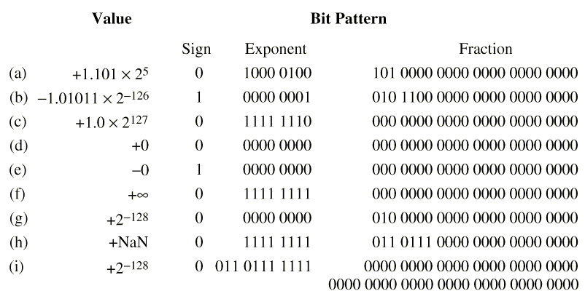
IEEE 754 Examples Source: Murdocca and Heuring, Principles of Computer Architecture (2000, Prentice-Hall)

Slide 38
IEEE-754 Conversion
For the following single-precision IEEE 754 bit patterns show the numeric value as a base 2 significand with an exponent (e.g. 1.11 x 2⁵)
0 10000011 01100000000000000000000
1 10000000 00000000000000000000000
0 00000001 10010000000000000000000
0 00000011 01101000000000000000000
1 11111110 11010000000000000000000

Slide 39
IEEE-754 Conversion
Show the IEEE 754 (single precision) bit patterns for the following numbers
+1.1011 x 2⁵
-1.0101 x 2⁻²
+1.1 x 2²
+34.625
-55.875

Slide 40
Arithmetic Operations
Addition: binary addition
Subtraction: take the 2’s complement of the subtrahend and add.
Sign Extension: needed to add two numbers which have different number of bits
Overflow: If operands are too big, then sum cannot be represented as an n-bit 2’s comp number.
We have overflow if signs of both operands are the same, and sign of sum is different.

Slide 41
Logical Operations
AND operation
bitwise operation between two operands
Application: clear (reset) bit values
OR operation
bitwise operation between two operands
Application: setting bit values, checking values
XOR operation
bitwise operation between two operands
Application: reversing bit/s
NOT operation
reverses all bits in operand

Slide 42
AND Truth Table
A | B | A AND B
False | False | False
False | True | False
True | False | False
True | True | True

Slide 43
OR Truth Table
A | B | A OR B
False | False | False
False | True | True
True | False | True
True | True | True

Slide 44
XOR Truth Table
A | B | A XOR B
False | False | False
False | True | True
True | False | True
True | True | False

Slide 45
NOT Truth Table
A | NOT A
False | True
True | False

Slide 46
Exercise: Identify both the mask and the Boolean operation needed to accomplish each of the following objectives.
change a lowercase ASCII code character to uppercase
convert a single decimal digit to ASCII
put 0s in the middle four bits of an eight-bit pattern without disturbing the other bits
complement a pattern of eight bits
complement the most significant bit of an 8-bit pattern without changing the other bits
put a 1 in the most significant bit of an 8-bit pattern without disturbing the other bits
put 1s in all but the most significant bit of an 8-bit pattern without disturbing the most significant bit

Slide 47
Reading Assignment
Chapter 3 Digital Logic Structures

